Slide 1
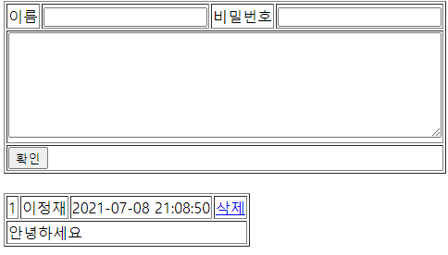
guestbook2 개요 및 분석
01
분석-리스트
Rqeust(요청)
Tomcat
http://localhost:8088/guestbook2/gbc?action=list
guestbook2
Request header
파라미터: action=list
Request body
Rquest
파라미터
action=list
Contoller
(servlet)객체
Dao 객체
List()
list일때
response
Rquest
파라미터
action=list
*포워드
Response(응답)
list.jsp
객체
response
Response(응답)
Response header
Response body
(html)
DB

Slide 2
guestbook2 개요 및 분석
01
분석-add
Rqeust(요청)
Tomcat
http://localhost:8088/guestbook2/gbc?action=add&name=name 값 &password=password 값 &content=content값
guestbook2
Request header
파라미터: action=add&name=name 값 &password=password 값 &content=content값
Request body
//list.jsp
Rquest
파라미터
action=add&name=name 값 &password=password 값 &content=content값
Dao 객체
guestInsert()
Contoller
(servlet)객체
add일때
Response(응답)
response
Response(응답)
Response header
Response body
//리다이렉트
DB

Slide 3

guestbook2 개요 및 분석
01
분석-deleteForm
Rqeust(요청)
Tomcat
http://localhost:8088/guestbook2/gbc?action=dform
guestbook2
Request header
파라미터: action=dform
Request body
Rquest
파라미터
action=dform
Contoller
(servlet)객체
response
dform일때
Rquest
파라미터
action=dform
*포워드
response
deleteForm.jsp
Response(응답)
Response(응답)
Response header
Response body

Slide 4
guestbook2 개요 및 분석
01
분석-delete
Rqeust(요청)
Tomcat
guestbook2
http://localhost:8088/guestbook2/gbc?action=dform
Request header
파라미터: action=dform
Request body
Contoller
(servlet)객체
Dao 객체
Rquest
파라미터
action=dform
dform
guestDelete()
response
Response(응답)
Response(응답)
Response header
Response body
DB

